Slide 1
Use CNN to identify digits and letters
Jianyu pang, feng wang

Slide 2
statement
In lab 6 we learned how to use SVM to identify. Since we what to identify all digits and letters, and SVM performed poorly, that is, spent a great deal of time (nearly 15 minutes) to obtain an accuracy around 82.82%, we want to use CNN to do the same problem and expect better result.

Slide 3
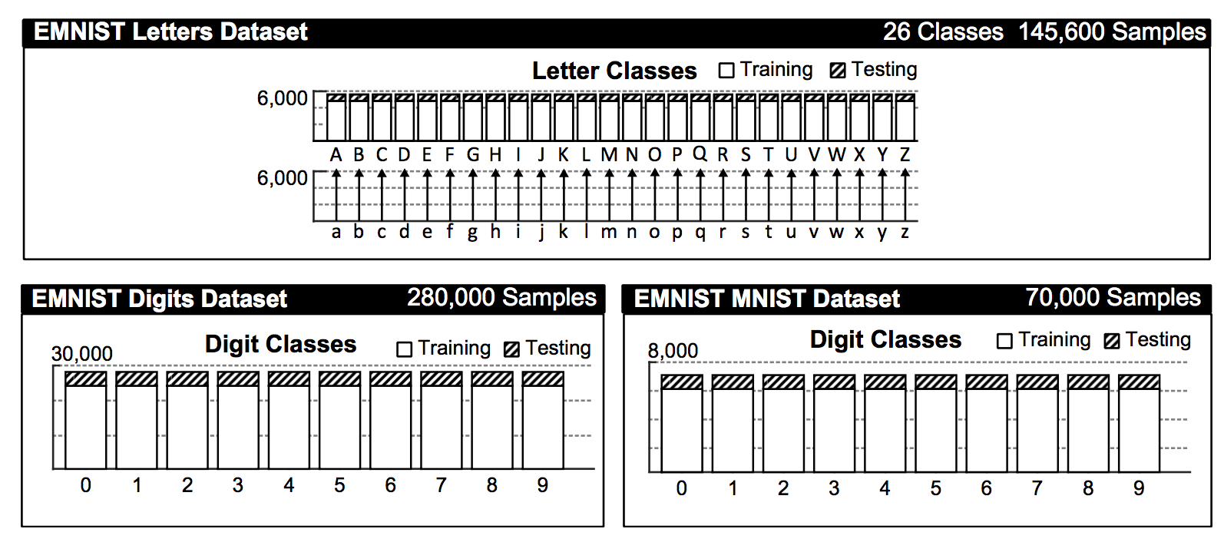
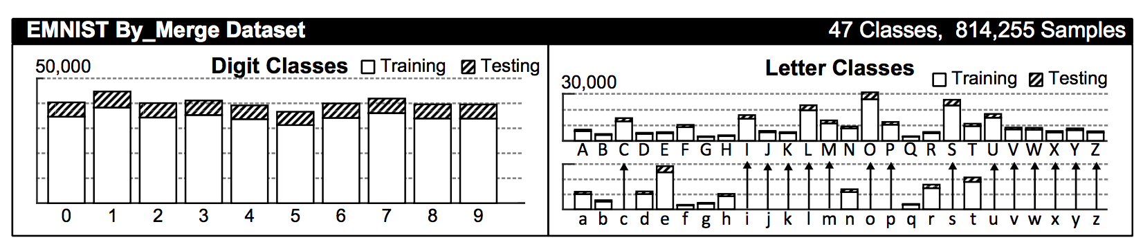
Dataset description
our data set is still EMNIST^{[1]} , and we use the emnist-digits.mat, emnist-letters.mat at first as the demo, then we use emnist-bymerge.mat, which has merged C, I, J, K, L, M, O, P, S, U, V, W, X, Y and Z as one class to get a total 47classes.
If we aim at creating a hand writing prediction app, using 47 classes dataset can provide better performance by judging the capital letters and small letters.

Slide 4
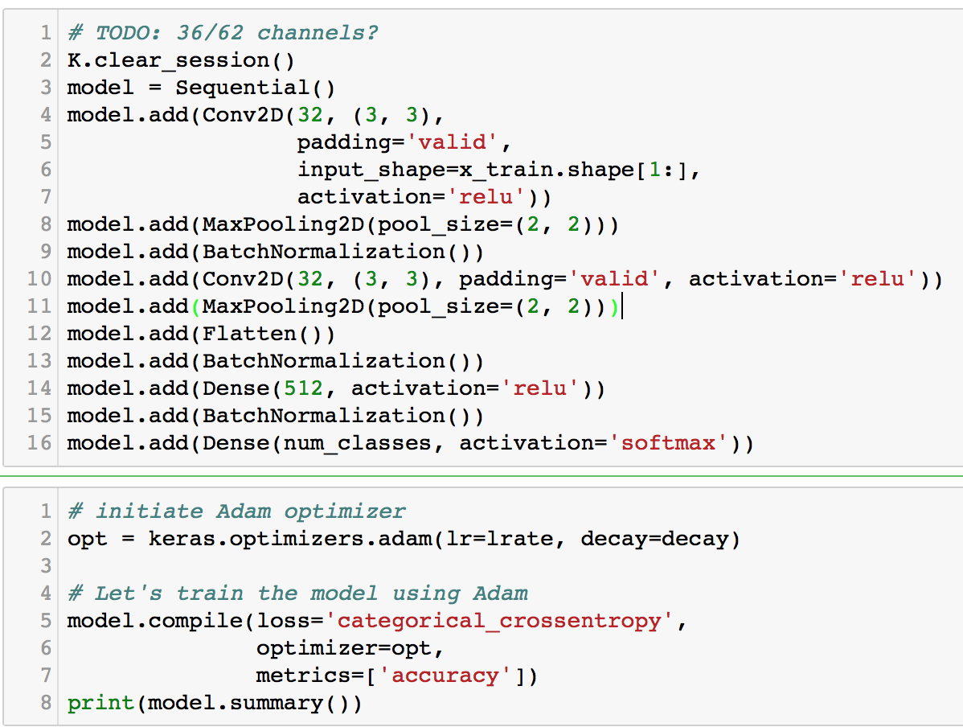
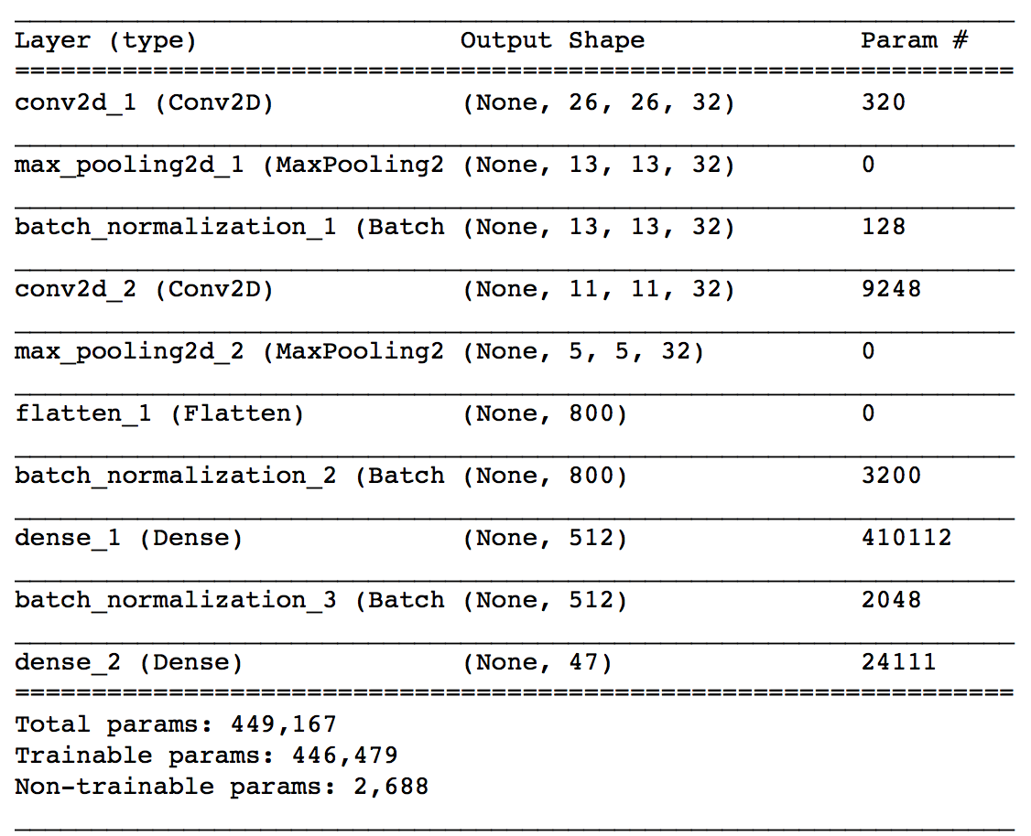
Formulation
As showed in the figure, we use valid padding in the convolution layers and use relu in every layer except the last layer using softmax. Since we have 36/47 classes, we use categorical crossentropy as the loss function. (notice that we should use one-hot on the target to apply this loss function) we use adam as the optimizer and adding batch normalization layers which is very important in this case.

Slide 5
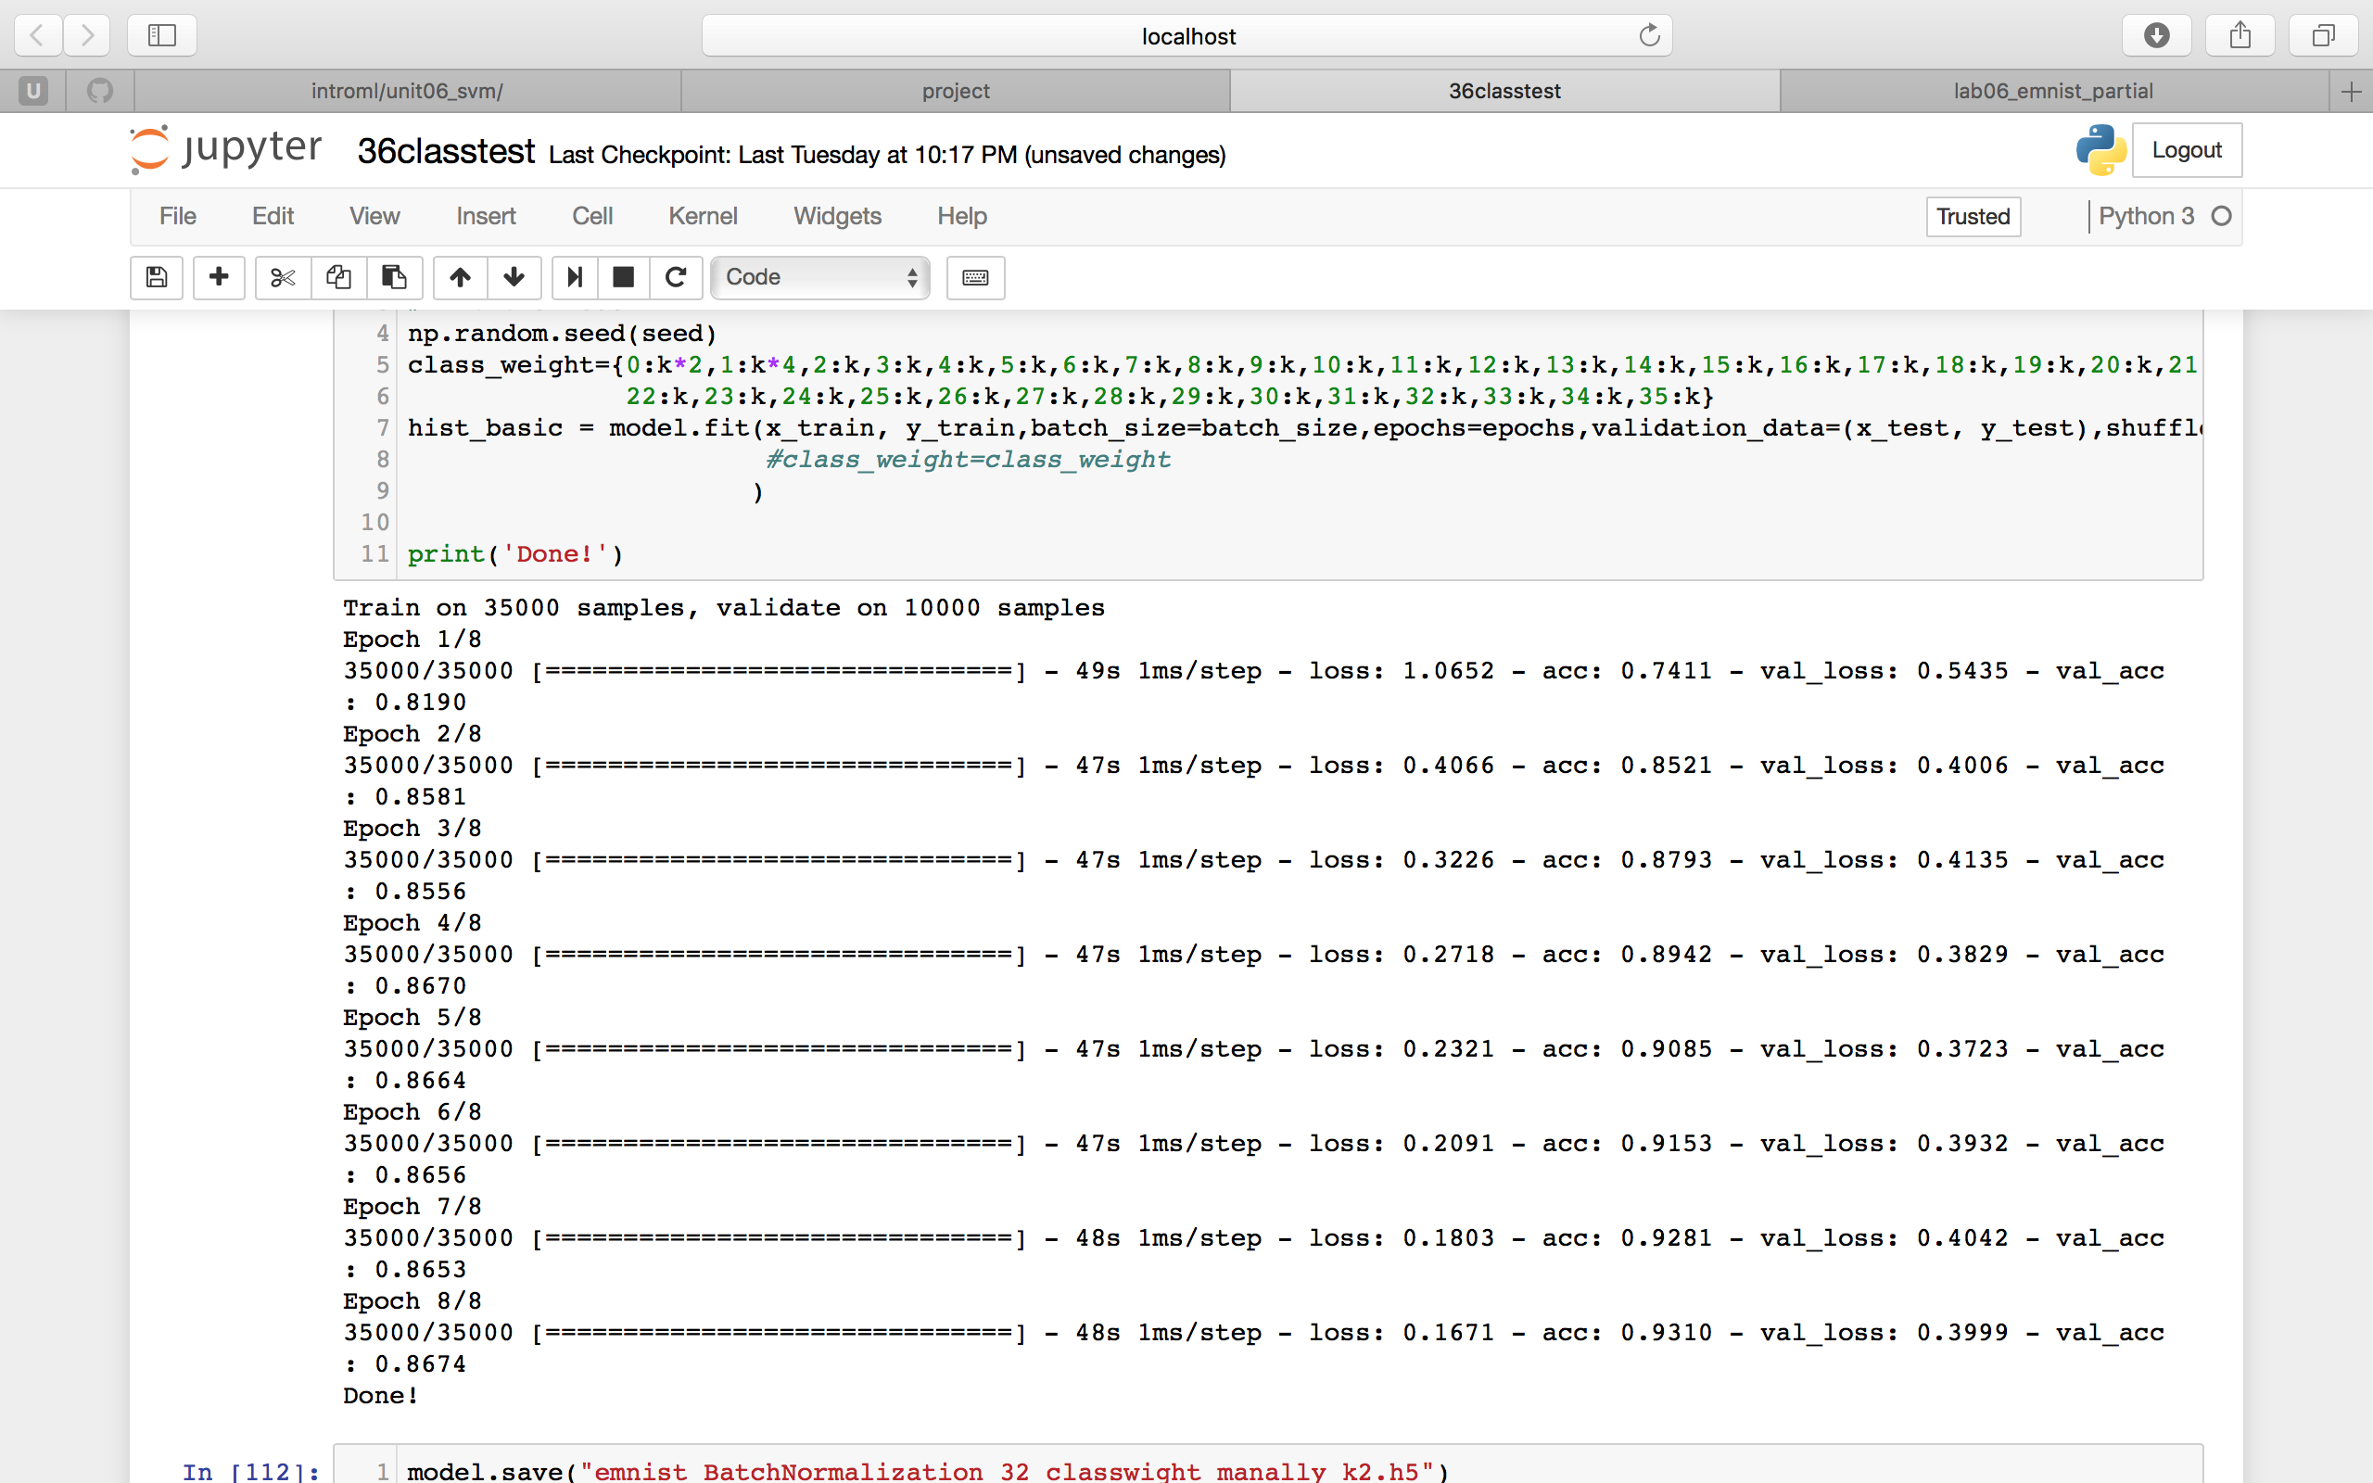
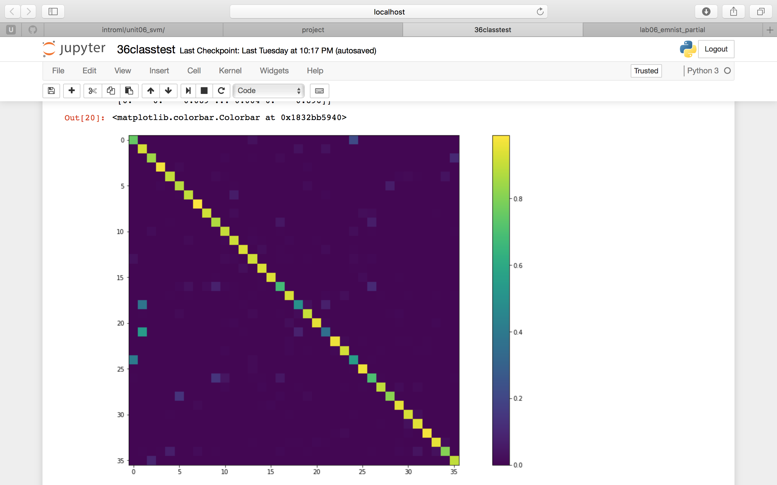
Start with 36 classes auto class weight, max val_acc:0.8674. the confuse matrix can be modified mannally.

Slide 6

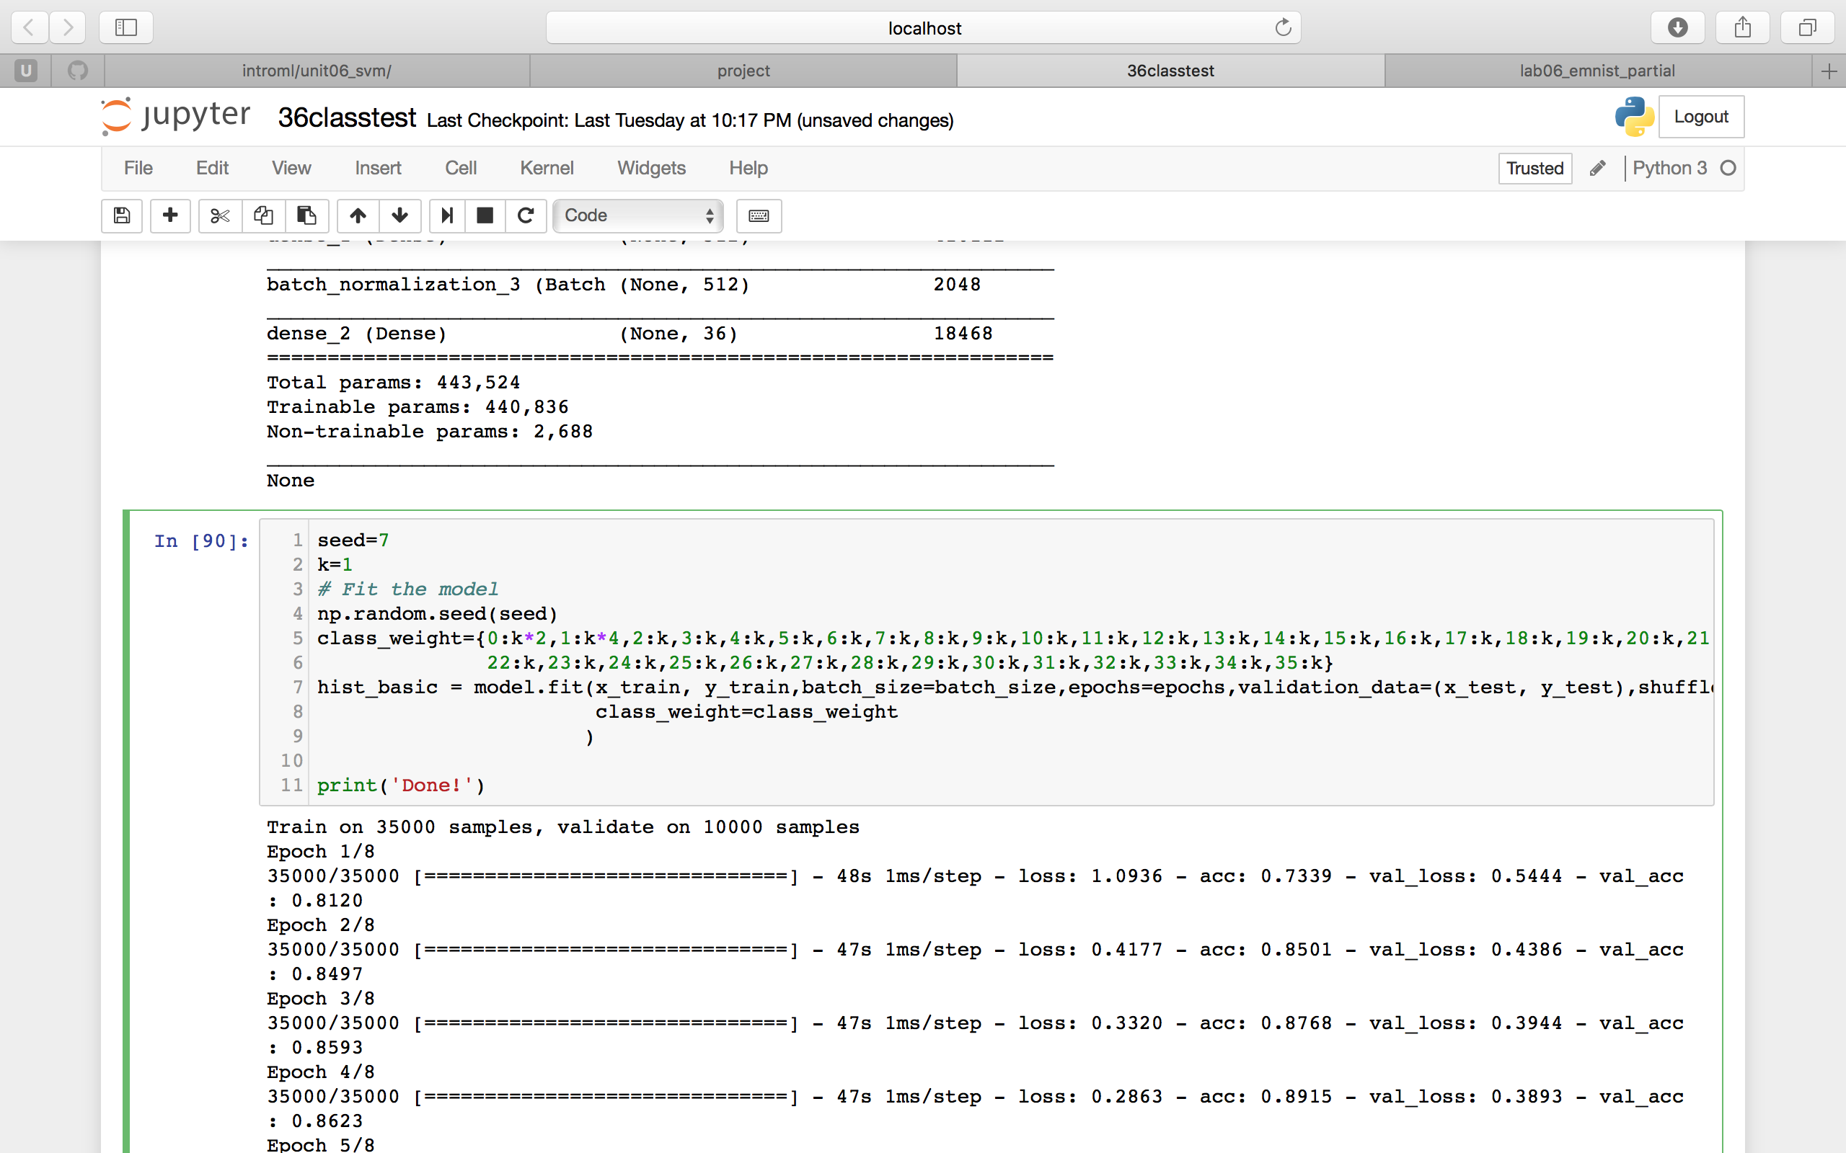
By manally change the class weight, we can get a more balance confusion matrix, but will cost val_accuracy decrease.

Slide 7
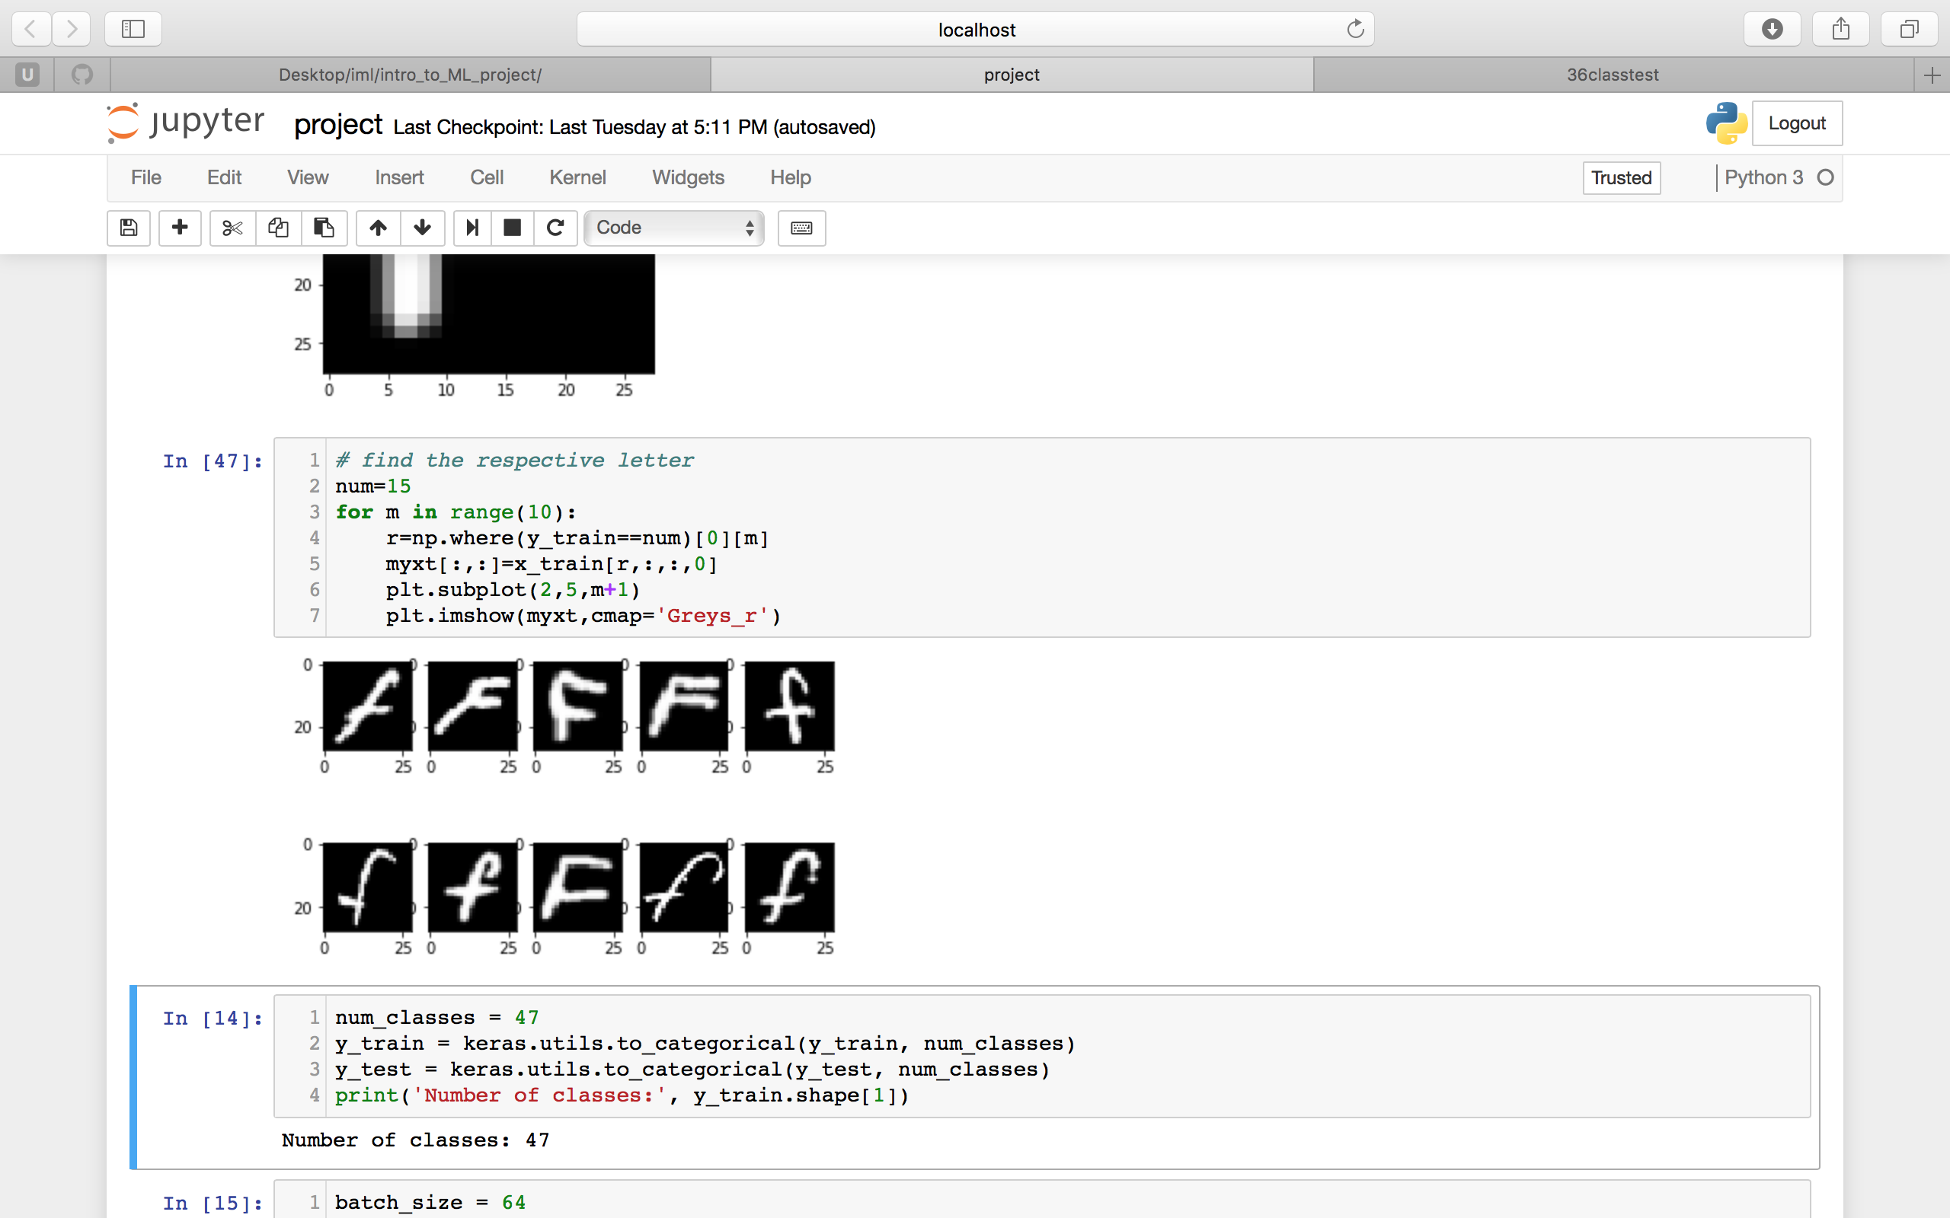
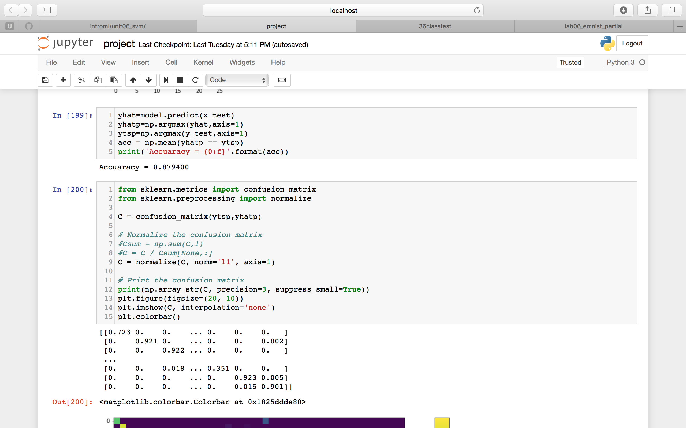
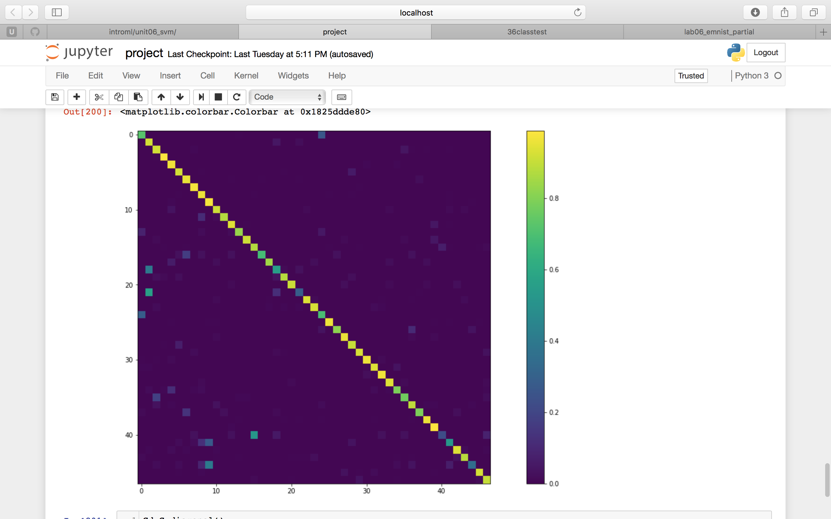
Main body : 47 classes no class weight, max val_acc: 0.8794
We can see that the data set uses number 15 to represent “F”, which is written as both capital F and f in the set, which will be regarded as f of number 40.
➤
It is acceptable for us to witness misclassification between 1:1/18:i/21:l and 9:9/g:g because they look like each other. What surprise us is the misdetection between 15:F and 40:f.
Confusion matrix shows great misclassification in 15: F/40: f ➤

Slide 8
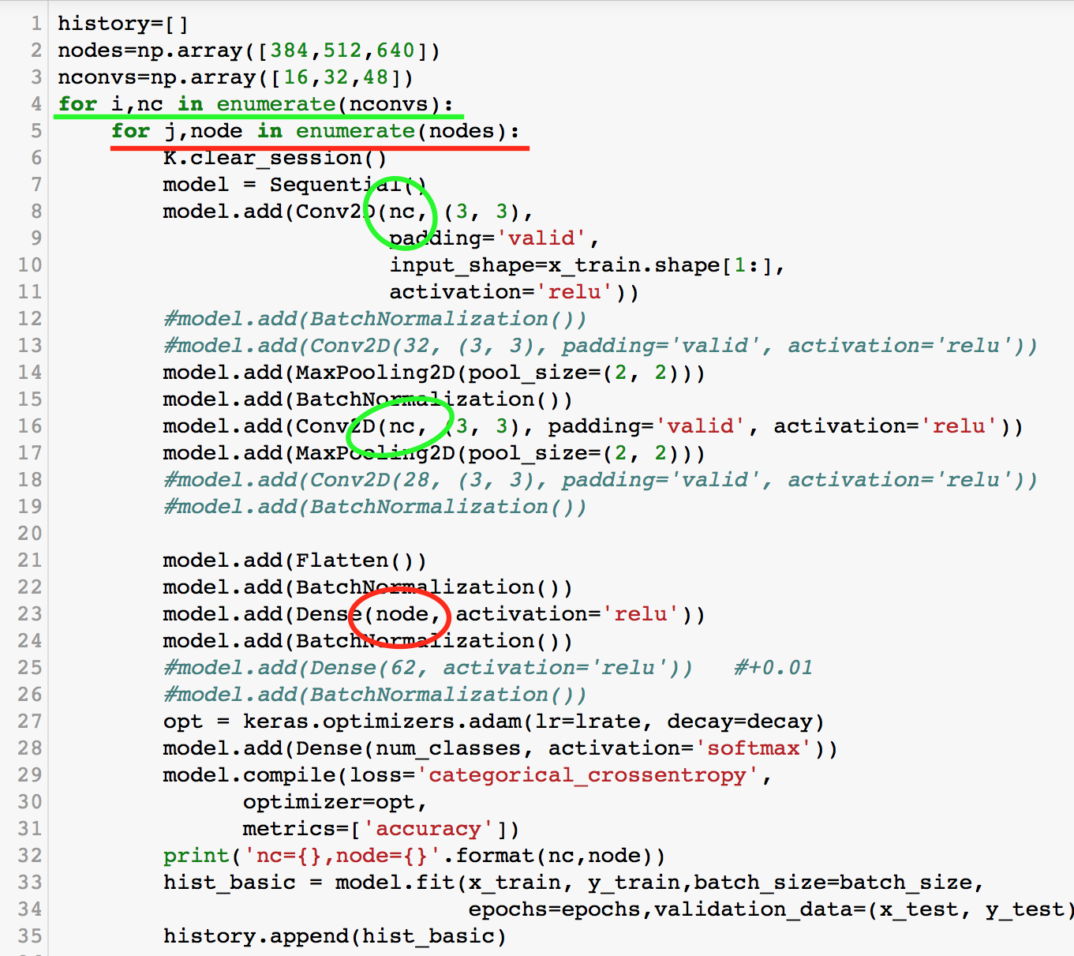
Loop over the number of channels to increase the performance. After finding the best channels number, we can loop over the learning rate of optimizer.

Slide 9
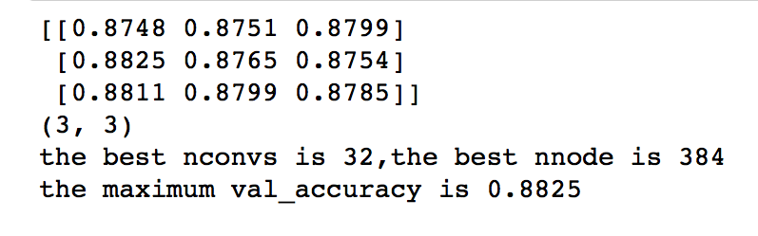
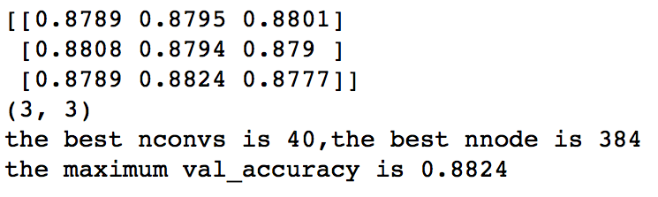
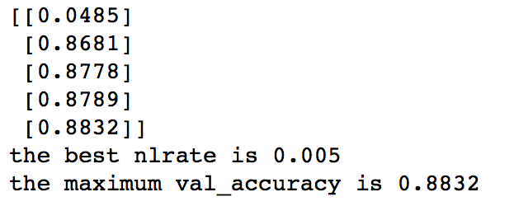
First we loop through nconvs= ([16,32,48]) and nnodes= ([384,512,640]),
Then we loop through nconvs= ([24,32,40]) and nnodes= ([320,384,448]) base on the previous result.
Finally loop through lrates= ([0.5,0.1,0.05,0.01,0.005]) and reach the validation accuracy of 0.8832

Slide 10
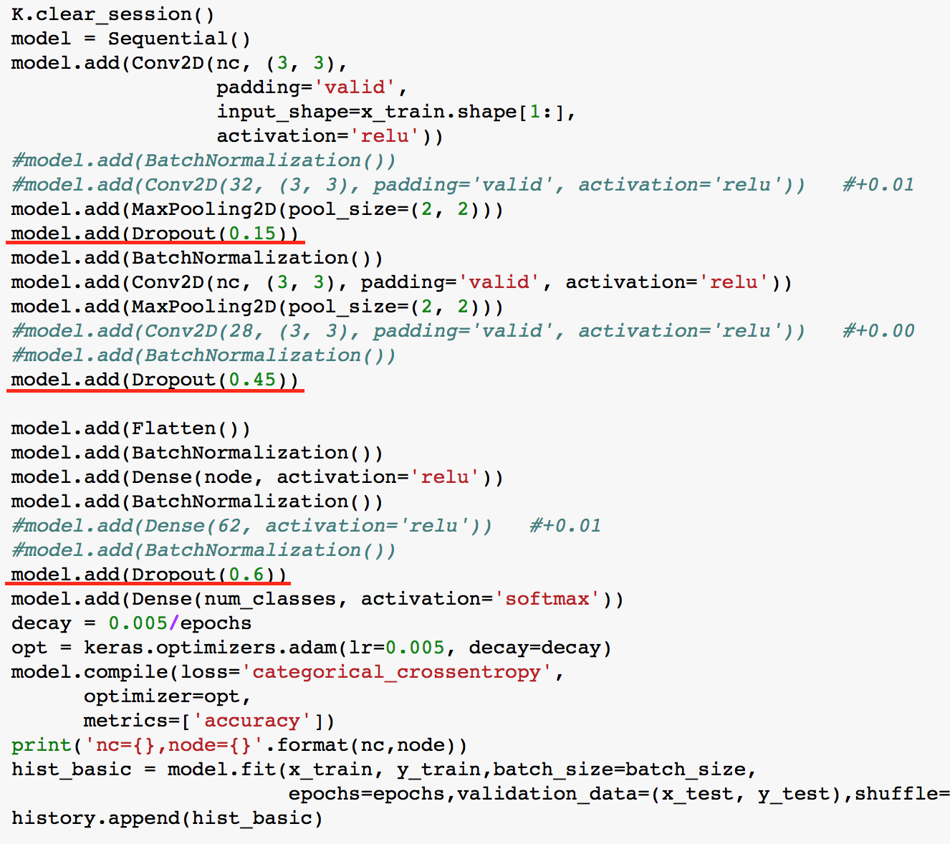
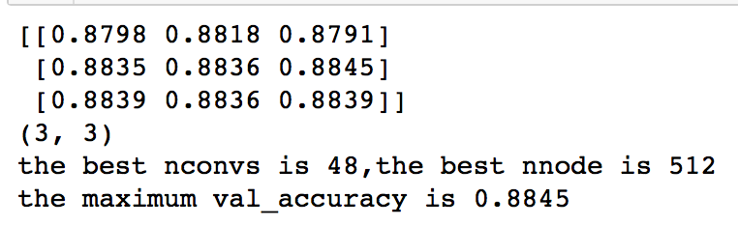
Achieved higher accuracy by adding dropout
Also use the cross validation to acquire the best parameters
Finally, by using nconv=48 and nnode=512 , the accuracy reach 0.8845

Slide 11
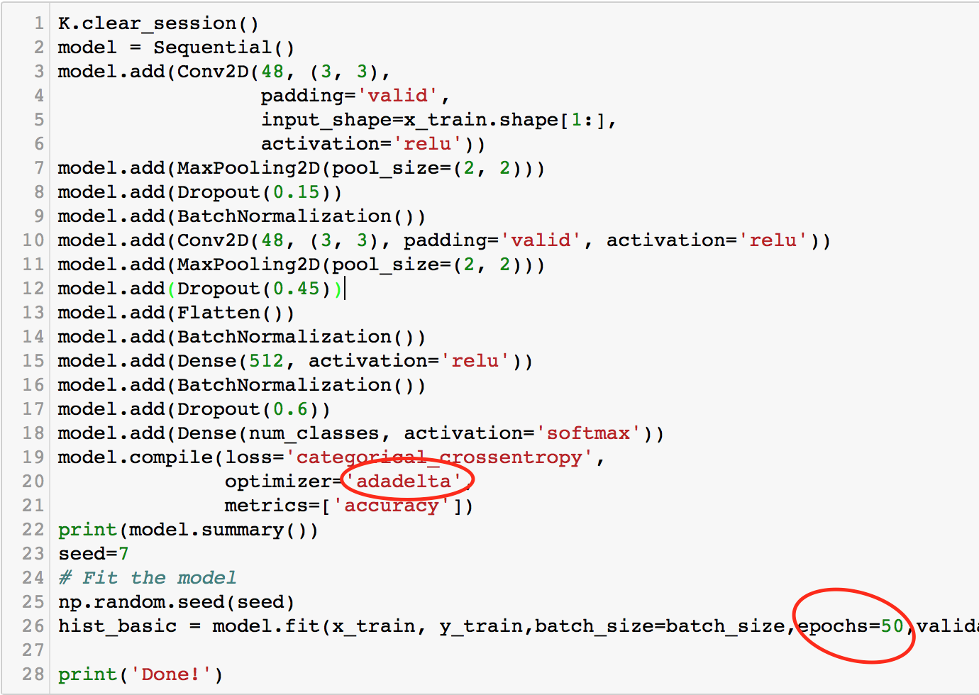
See how far we can go
We want to find the maximum validation accuracy regardless of the time consume, so we run more epochs (50 instead of 8) to achieve a better result.
By replacing the optimizer adam with adadelta, we finally get the maximum validation accuracy 0.8948 in the 45th epoch.

Slide 12
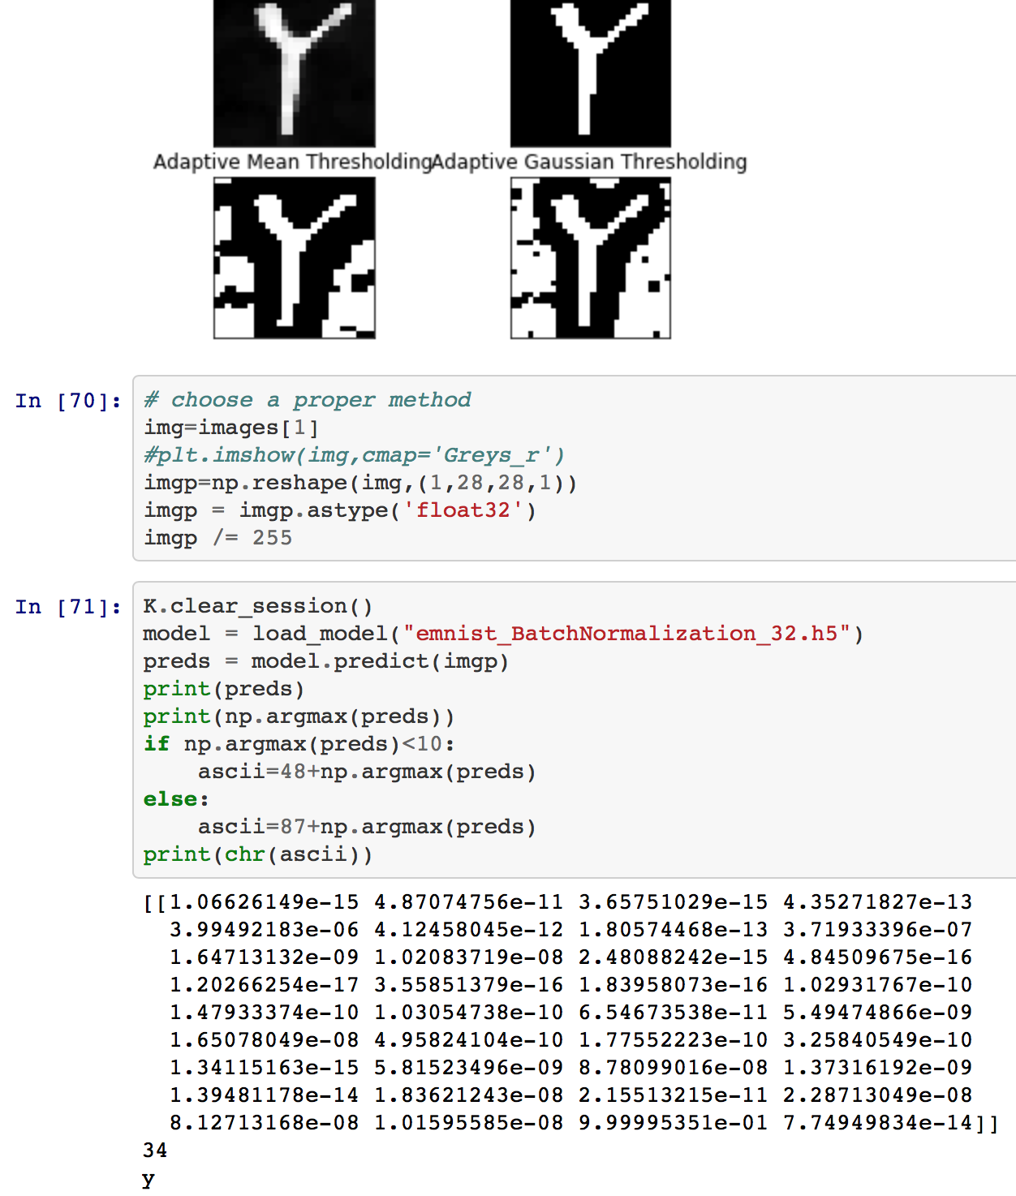
Bonus program
We also wrote a tiny program that can shows the prediction of the input figure by using the project program we wrote. (photo_to_2828_gray.ipynb)

Slide 13
Conclusion
Save a great amount of time by using CNN instead of SVM to identify the letters and digits. (training 46000 samples in SVM using 30 min, training 46000 samples in CNN using 8 min)
Obtain a higher accuracy by using CNN(0.8845) instead of SVM(0.8448)
Have a brighter future since we can go deeper to the deep learning region.
To be more specific, go to https://github.com/jianyupang/iml-project and verify project.ipynb

Slide 14
Future scope
In order to increase the accuracy, we also try to use the VGG16 pre-trained program on the new dataset, but the result is not ideal(only around 0.8 accuracy), that might due to the lack of digits and letters training data in the VGG16. (project_VGG16.ippynb)
We can go deeper by adding more layers in the CNN to get better result if we can access to a GPU and even try many different advance ways listed on the leaderboard of EMNIST

